Slide 1
Regression Analysis
Logistic Regression
Nicoleta Serban, Ph.D.
Professor
Stewart School of Industrial and Systems Engineering
The Demographics of Obesity: Modeling and Prediction

Slide 2

About This Lesson

Slide 3
Model Estimation
## Fit a logistic regression model
model = glm(Obesity~agegr+gender+edu, family=binomial)
summary(model)
…
…
Null deviance: 5739.9 on 4313 degrees of freedom
Residual deviance: 5641.3 on 4304 degrees of freedom
…
 | Estimate | Std. Error | z value | Pr(>|z|)
(Intercept) | -1.20581 | 0.15730 | -7.666 | 1.78e-14 ***
agegr25to34 | 0.47271 | 0.14428 | 3.276 | 0.001052 **
agegr35to44 | 0.76486 | 0.14196 | 5.388 | 7.13e-08 ***
agegr45to64 | 0.84815 | 0.13240 | 6.406 | 1.49e-10 ***
agegr65+ | 0.60086 | 0.13751 | 4.370 | 1.24e-05 ***
genderFemale | 0.23041 | 0.06363 | 3.621 | 0.000293 ***
edu9to11Grade | 0.05632 | 0.12229 | 0.461 | 0.645110
eduHighSchool | -0.03440 | 0.11436 | -0.301 | 0.763579
eduSomeCollege | 0.13947 | 0.11036 | 1.264 | 0.206301
eduCollege+ | -0.40077 | 0.11757 | -3.409 | 0.000653 ***

Slide 4
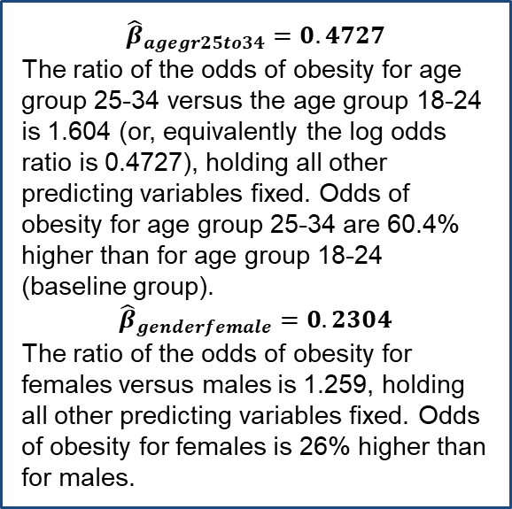
Model Estimation
## Fit a logistic regression model
model = glm(Obesity~agegr+gender+edu, family=binomial)
summary(model)
…
…
Null deviance: 5739.9 on 4313 degrees of freedom
Residual deviance: 5641.3 on 4304 degrees of freedom
…
${\hat{β}}_{agegr25to34}=0.4727$
The ratio of the odds of obesity for age group 25-34 versus the age group 18-24 is 1.604 (or, equivalently the log odds ratio is 0.4727), holding all other predicting variables fixed. Odds of obesity for age group 25-34 are 60.4% higher than for age group 18-24 (baseline group).
$${\hat{β}}_{genderfemale}=0.2304$$
The ratio of the odds of obesity for females versus males is 1.259, holding all other predicting variables fixed. Odds of obesity for females is 26% higher than for males.
 | Estimate | Std. Error | z value | Pr(>|z|)
(Intercept) | -1.20581 | 0.15730 | -7.666 | 1.78e-14 ***
agegr25to34 | 0.47271 | 0.14428 | 3.276 | 0.001052 **
agegr35to44 | 0.76486 | 0.14196 | 5.388 | 7.13e-08 ***
agegr45to64 | 0.84815 | 0.13240 | 6.406 | 1.49e-10 ***
agegr65+ | 0.60086 | 0.13751 | 4.370 | 1.24e-05 ***
genderFemale | 0.23041 | 0.06363 | 3.621 | 0.000293 ***
edu9to11Grade | 0.05632 | 0.12229 | 0.461 | 0.645110
eduHighSchool | -0.03440 | 0.11436 | -0.301 | 0.763579
eduSomeCollege | 0.13947 | 0.11036 | 1.264 | 0.206301
eduCollege+ | -0.40077 | 0.11757 | -3.409 | 0.000653 ***

Slide 5
Statistical Inference
## Test for overall regression
gstat = model$null.deviance - deviance(model)
cbind(gstat, 1-pchisq(gstat,length(coef(model))-1))
gstat
[1,] 98.63672 0
round(coefficients(summary(model))[,4],4)
(Intercept) agegr25to34 agegr35to44 agegr45to64 agegr65+
0.0000 0.0011 0.0000 0.0000 0.0000
genderFemale edu9to11Grade eduHighSchool eduSomeCollege eduCollege+
0.0003 0.6451 0.7636 0.2063 0.0007
Test for overall regression: p-value ≈ 0 (< 0.01). Reject the null hypothesis that all regression coefficients are zero. Conclude there are predicting variables that explain the variability in obesity.
Except for one, education regression coefficients are not statistically significant given that we account for age and gender.

Slide 6
Predictive Power
## Prediction Accuracy
library(boot)
cost0.5 = function(y, pi){
  ypred=rep(0,length(y))
  ypred[pi>0.5] = 1
  err = mean(abs(y-ypred))
  return(err)}
obdata.fr = data.frame(cbind(Obesity, agegr, gender, edu))
## classification error for 10-fold cross-validation
cv.err = cv.glm(obdata.fr, model, cost=cost0.5, K=10)$delta[1]
⋮
cv.err = c(cv.err0.3, cv.err0.35, cv.err0.4, cv.err0.45, cv.err0.5,
cv.err0.55, cv.err0.6, cv.err0.65)
## Smallest prediction error is 0.3824
plot(c(0.3, 0.35, 0.4, 0.45, 0.5, 0.55, 0.6, 0.65), cv.err,
type="l", lwd=3, xlab="Threshold", ylab="CV Classification Error")

Slide 7
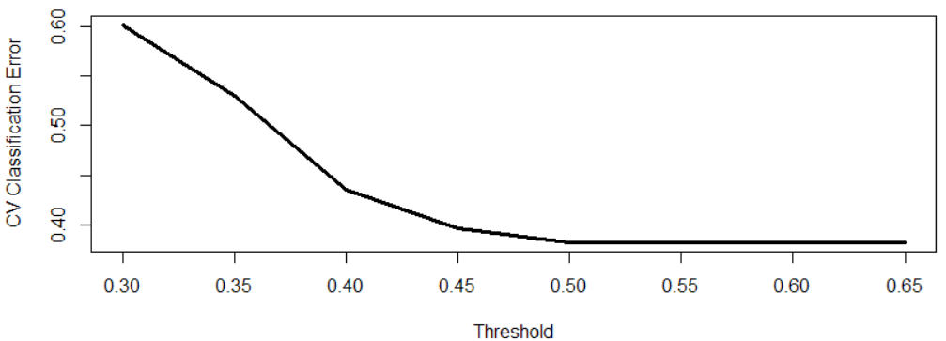
Predictive Power
Prediction accuracy is highest and equal for thresholds above 0.5. Why?
It is the same prediction accuracy as if we were to replace all predictions with 0 (that is, predict everyone is not obese).
The model has no predictive power since it performs worse than prediction without modeling.

Slide 8
Prediction for Test Data
## Prediction given a set of new observations
## Prepare the test data
testobdata = read.table("testobesitydata.txt", h=T)
agegr.t = factor(testobdata$AgeGroup, labels=c("18to24", "25to34", "35to44",
"45to64", "65+"))
gender.t = factor(testobdata$Gender, labels=c("Male","Female"))
edu.t = factor(testobdata$Education, labels=c("<9thGrade","9to11Grade",
"HighSchool", "SomeCollege", "College+"))
pred.data = data.frame(agegr=agegr.t, gender=gender.t, edu=edu.t)
### Predict
pred.test = predict.glm(model,pred.data,type="response")
### Prediction Accuracy for multiple thresholds
err0.3 = cost0.3(testobdata$Obesity, pred.test)
⋮
err0.65 = cost0.65(testobdata$Obesity, pred.test)
err = c(err0.3, err0.35, err0.4, err0.45, err0.5, err0.55, err0.6, err0.65)
plot(c(0.3, 0.35, 0.4, 0.45, 0.5, 0.55, 0.6, 0.65), err,
type="l", lwd=3, xlab="Threshold", ylab="Classification Error")

Slide 9
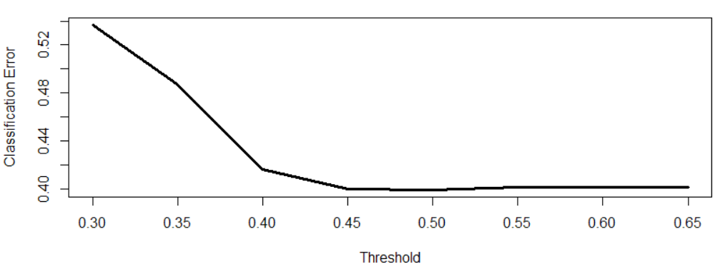
Prediction for Test Data
Prediction accuracy is highest at 0.5; it is similar as the prediction accuracy if we were to predict everyone is not obese.
The prediction accuracy using the fitted model did not improve for the test data.

Slide 10

Summary

